Slide 1
CCM v0.34

Slide 2
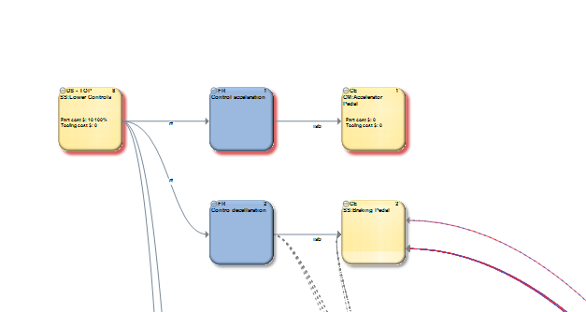
Copy and Paste in DR-view
Mark (drag with right mouse button) and press Ctrl+C to copy
Press Ctrl+V to paste. Pasted objects is added and marked and follow cursor until mouse clicked.
Notes:
Top DS are pasted as regular DS as there can only be one top DS
Possible to paste in other DR and in also in a another CC.
Only internal connections are preserved

Slide 3
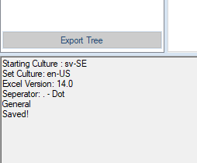
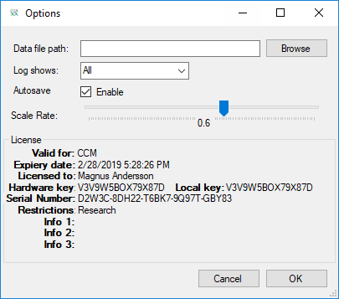
New save options
Use Ctrl+S to save. Can be used from main window and Edit CC
Possible to activate autosave. User choice will follow model.
Save interval is every minute
Notes:
Backup (.bak-file) is created on first autosave each session. This gives a chance to revert if there’s a unwanted autosave.

Slide 4
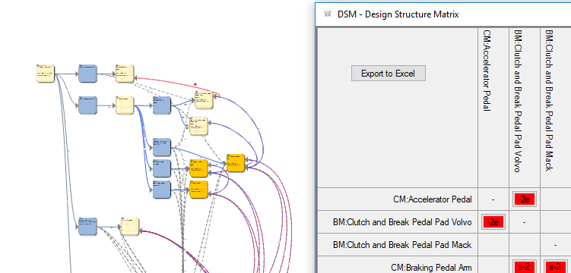
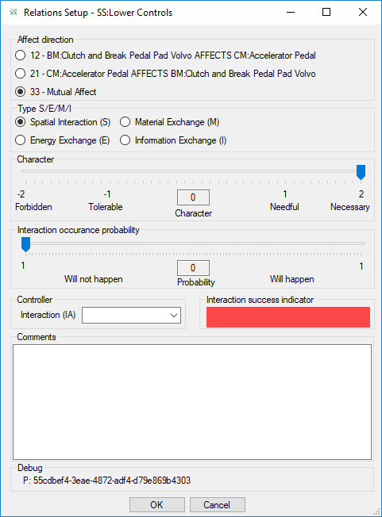
Edit IW from iw-matrix
Add new IW to by clicking in cell
Click on existing connection will highlight in DR-view
If clicked a second time, connection will be removed.
Notes:
Updates done in iw-matrix will instantly show in DR-view.
Updates done in DR-view will not happen in iw-matrix.
Default values are set as below

Slide 5
Excel Input
Fill template with data. Critical is to have same columns as template
Use import table and select Excel-file
CCM reads Excel-files and adds/modifies entries according to table
Notes:
CCM will try to find Paramter within DS and CC and modify value.
If CC, DS or Parameter is not existing, CCM will create these. This will be show in log.
Excel-template is attaced. This is not needed, as long as columns are matching.

Slide 6
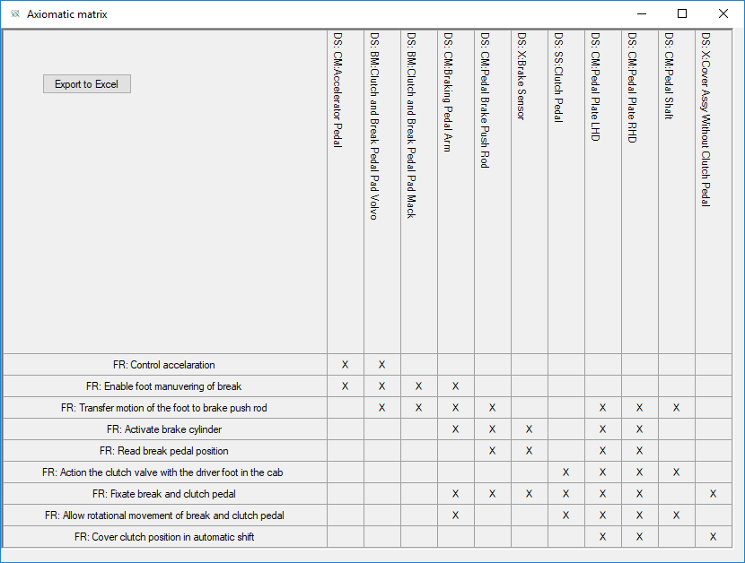
Bug fixes
If object is dragged with right mouse button, only structure connected with isb/rf will follow. Iib
iib-Matrix is updated to give more relaible results. Needs to be tested to verify correct results.
Some issues were related to FR with multiple DS resulting nonsquare matrix that wasn’t handled.
Notes:

